Slide 1
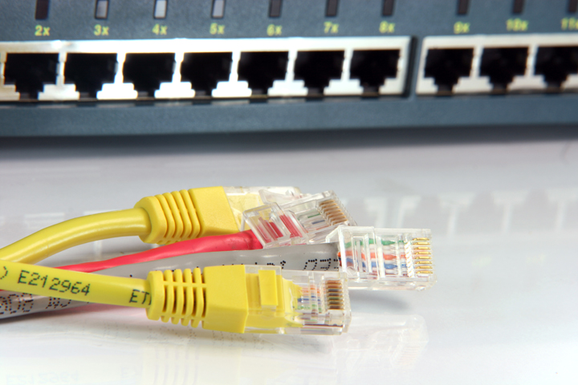
IP
Communication Networks

Slide 2
Addressing
Each station must be addressable
Two kinds of addresses:
1) Physical addressing (MAC addresses)
2) Logical addressing (IP addresses)
The communicating applications (source/ destination applications) must also be identifiable
Identified through TCP ports
A socket (IP address + TCP port) identifies both an application and the machine it’s on.

Slide 3
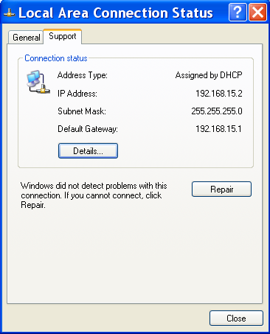
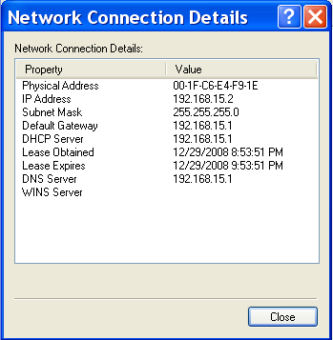
Physical Addressing: MAC
MAC Address: 48 bits (Ethernet)
Flat addressing
Usually non-configurable
Notes:
Courtesy: www.layertwo.net
www.tcpipguide.com

Slide 4
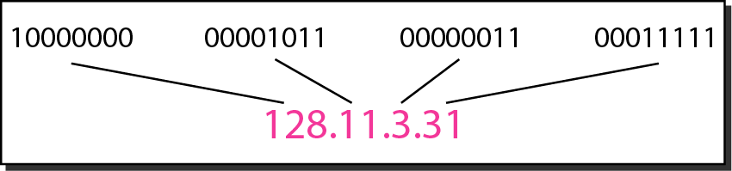
Dotted-decimal notation and binary notation for an IPv4 address

Slide 5
Change the following IPv4 addresses from binary notation to dotted-decimal notation.
Solution
We replace each group of 8 bits with its equivalent decimal number (see Appendix B) and add dots for separation.

Slide 6
Change the following IPv4 addresses from dotted-decimal notation to binary notation.
Solution
We replace each decimal number with its binary equivalent (see Appendix B).

Slide 7
Find the error, if any, in the following IPv4 addresses.
Solution
a. There must be no leading zero (045).
b. There can be no more than four numbers.
c. Each number needs to be less than or equal to 255.
d. A mixture of binary notation and dotted-decimal notation is not allowed.

Slide 8
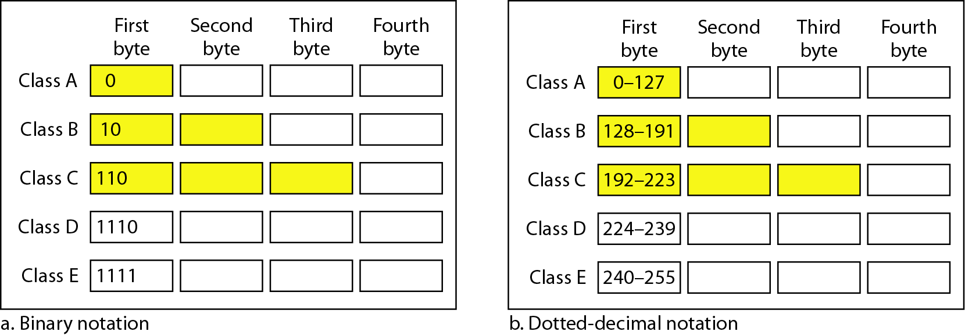
Finding the classes in binary and dotted-decimal notation

Slide 9
Find the class of each address.
a. 00000001 00001011 00001011 11101111
b. 11000001 10000011 00011011 11111111
c. 14.23.120.8
d. 252.5.15.111
Solution
a. The first bit is 0. This is a class A address.
b. The first 2 bits are 1; the third bit is 0. This is a class C address.
c. The first byte is 14; the class is A.
d. The first byte is 252; the class is E.

Slide 10
Logical Addressing: IP
4,294,967,296
possible addresses = 2³²
IP Version 4; Address: 32 bits
IP Version 6; Address: 128 bits
Hierarchical addressing
2 parts: a network part and a host part.
Machines in a LAN have the same network part; they differ in host parts
How is the network part of an IP address defined
?
?
?
Subnet mask
Notes:
Courtesy: www.layertwo.net
www.tcpipguide.com

Slide 11
IP (Internet Protocol)
IP Address
192.168.15.2 (decimal)
11000000 10101000
00001111 00000010 (binary)
Subnet Mask:
255.255.255.0 (decimal)
11111111 11111111
11111111 00000000 (binary)
IP Address
192.168.15.2 (decimal)
11000000 10101000
00001111 00000010 (binary)
Subnet Mask:
255.255.255.0 (decimal)
11111111 11111111
11111111 00000000 (binary)
Network part Host part
Notes:
Courtesy: www.layertwo.net
www.tcpipguide.com

Slide 12
Applications Identification
How to identify source/ destination application communicating
The source/ destination applications are identified through TCP ports
Common TCP Ports:
HTTP: 80; SMTP:25; DNS: 53
?
?
?

Slide 13
Naming
Machine addresses are difficult to memorize
Solution: Provide recognizable names to numerically addressed Internet resources.
Examples:
google.com; stanford.edu; niit.edu.pk
google.com; stanford.edu; niit.edu.pk
…, Third level domain, Second level domain; Top level domain (TLD);
List of TLDs:
http://en.wikipedia.org/wiki/List_of_Internet_top-level_domains

Slide 14
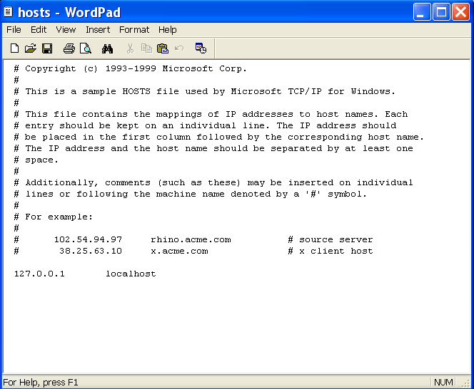
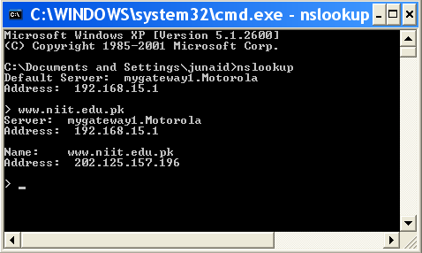
Naming
How to manage address to name mapping?
A hosts file on each machine
Unix/ Linux: /etc/hosts file
Windows: %SystemRoot%\system32\drivers\etc
A decentralized domain name server system
Scalable solution
The name to IP mapping is available at a DNS server
DNS servers are of two types
DNS Authoritative server (each domain has at least two authoritative servers)
DNS Caching server (each LAN can have one)
Notes:
Hosts file is used in small networks or as supplement to the next option

Slide 15
Example application
To clarify concepts, let us assume a greatly simplified model of the
LAN of UIIT
Network’s domain name: uaar.edu.pk
WWW
P
C
Let’s assume that a student (in the uaar.edu.pk LAN) wishes to access NUST-SEECS website hosted at www.uaar.edu.pk

Slide 16
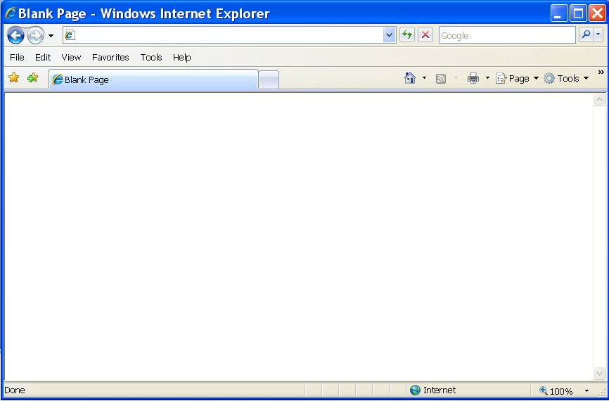
Example application
Address Bar
http://www.niit.edu.pk
This is an example of a browser (Internet Explorer)
Other browsers include Firefox, Opera.
Browser acts as:
a client of webserver
fetches and displays user requested documents
1
2

Slide 17
Example application (contd.)
The HTTP request sent
by the student PC (the machine pc.niit.edu.pk)
to the webserver (the machine www.niit.edu.pk) would be something like “GET / HTML/1.1”
Packet so far:
Outstanding issues:
How to send this request to Webserver?
Which application at webserver must process this packet?
GET / HTML/1.1
1
2

Slide 18
Example application (contd.)
D
N
S
WWW

Slide 19
DNS Client/Server Exchange
D
N
S
Request
WWW
Tell me the IP address of www.niit.edu.pk?

Slide 20
DNS Client/Server Exchange
D
N
S
Reply
WWW
The IP address of www.niit.edu.pk is 202.125.157.196
The IP address of www.niit.edu.pk is 202.125.157.196

Slide 21
Example application (contd.)
Which application at webserver must process this packet?
2
In TCP/IP, each well-known application is identified using ports.
The port of DNS is 53; HTTP is 80; SMTP is 25.
In our considered example, HTTP server application (port 80) would process the packet.
Packet so far:
Source Port | Destination Port | GET / HTML/1.1
> 1024 | 80 |

Slide 22
Example application (contd.)
The destination IP address (found through DNS)
is 202.125.157.196.
Let’s assume the source IP address is 202.125.157.150
(network must be same; to be explained later)
Packet so far:
Source IP | Destination IP | Source Port | Destination Port | GET / HTML/1.1
202.125.157.150 | 202.125.157.196 | > 1024 | 80 |
Logical addressing: network and host parts
*Assuming /24 subnet mask (to be explained later)

Slide 23
Example application (contd.)
How to send the created packet to Webserver?
3
To communicate with any host, its physical address (called MAC address) must be known.
How to resolve IP addresses to MAC addresses
Address Resolution Protocol (ARP)
?
?

Slide 24
Example application (contd.)
Now that the physical (MAC) addresses are known, communication can take place
The destination MAC address is 12:34:aa:bb:cc:dd
The source MAC address (let’s assume) is 23:34:aa:bb:cc:dd
IP packet containing the data
MAC frame
Source IP | Destination IP | Source Port | Destination Port | GET / HTML/1.1
202.125.157.150 | 202.125.157.196 | > 1024 | 80 |
Source MAC address | Destination MAC address
Payload
FCS

Slide 25
HTTP Client/Server Exchange
D
N
S
Request
WWW
Send me the index.html page for the host www.niit.edu.pk using HTTP version 1.1
Send me the index.html page for the host www.niit.edu.pk using HTTP version 1.1

Slide 26
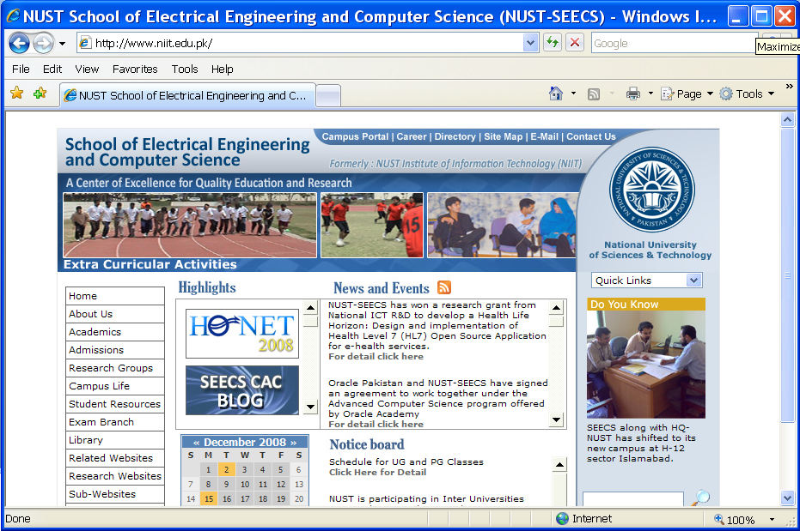
HTTP Client/Server Exchange
D
N
S
WWW
Reply
The index.html page in the wwwroot directory configured for the www.niit.edu.pk webserver is sent back to the browser for display

Slide 27
QUIZ
Change the following IPv4 addresses from dotted-decimal notation to binary notation and also write the subnet mask of this IP Address in view of the IP Class
i. 10.11.1.33 Subnet Mask ??
ii. 192.168.8.3 Subnet Mask ??

